Slide 1

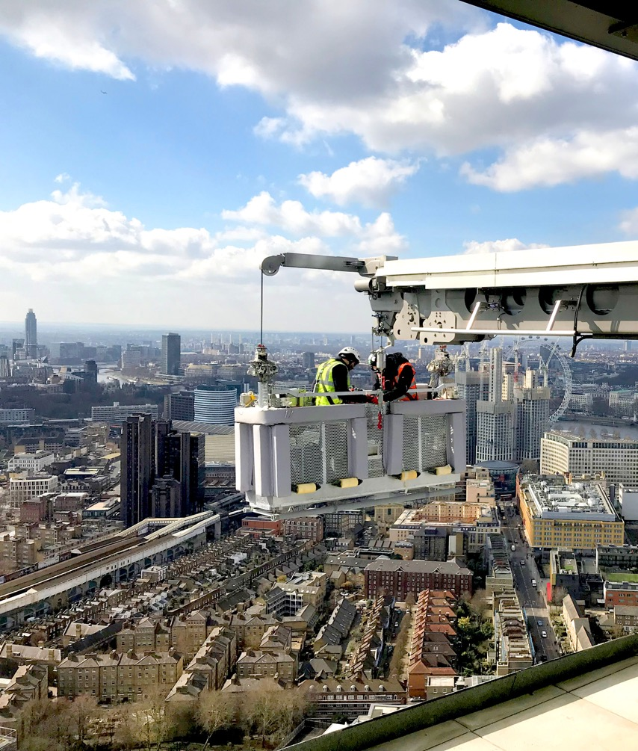
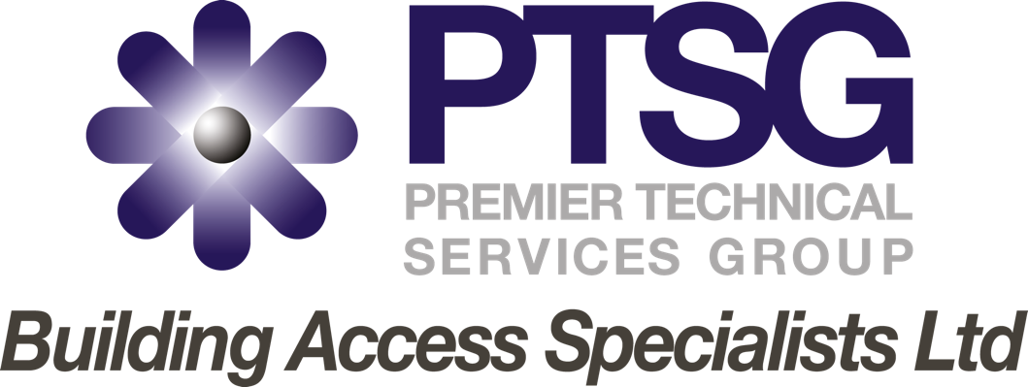

Slide 2

Contents
Introduction
Services
Organisation Structure
Contact
1

Slide 3
Introduction
PTSG BAS Ltd began as a company called Acescott, which was acquired by PTSG in 2014.
Acescott ceased trading under its own name in 2019, when it began trading as PTSG Building Access Specialists Ltd.
The company is London-based but has nationwide coverage.
PTSG BAS Ltd delivers specialist services in the following four areas:
  High-Level Cleaning (Windows, Facades, Roofs)
  Rope Access Solutions
  Building Fabric Maintenance
  Roof and Gutter Maintenance and repairs.
2

Slide 4
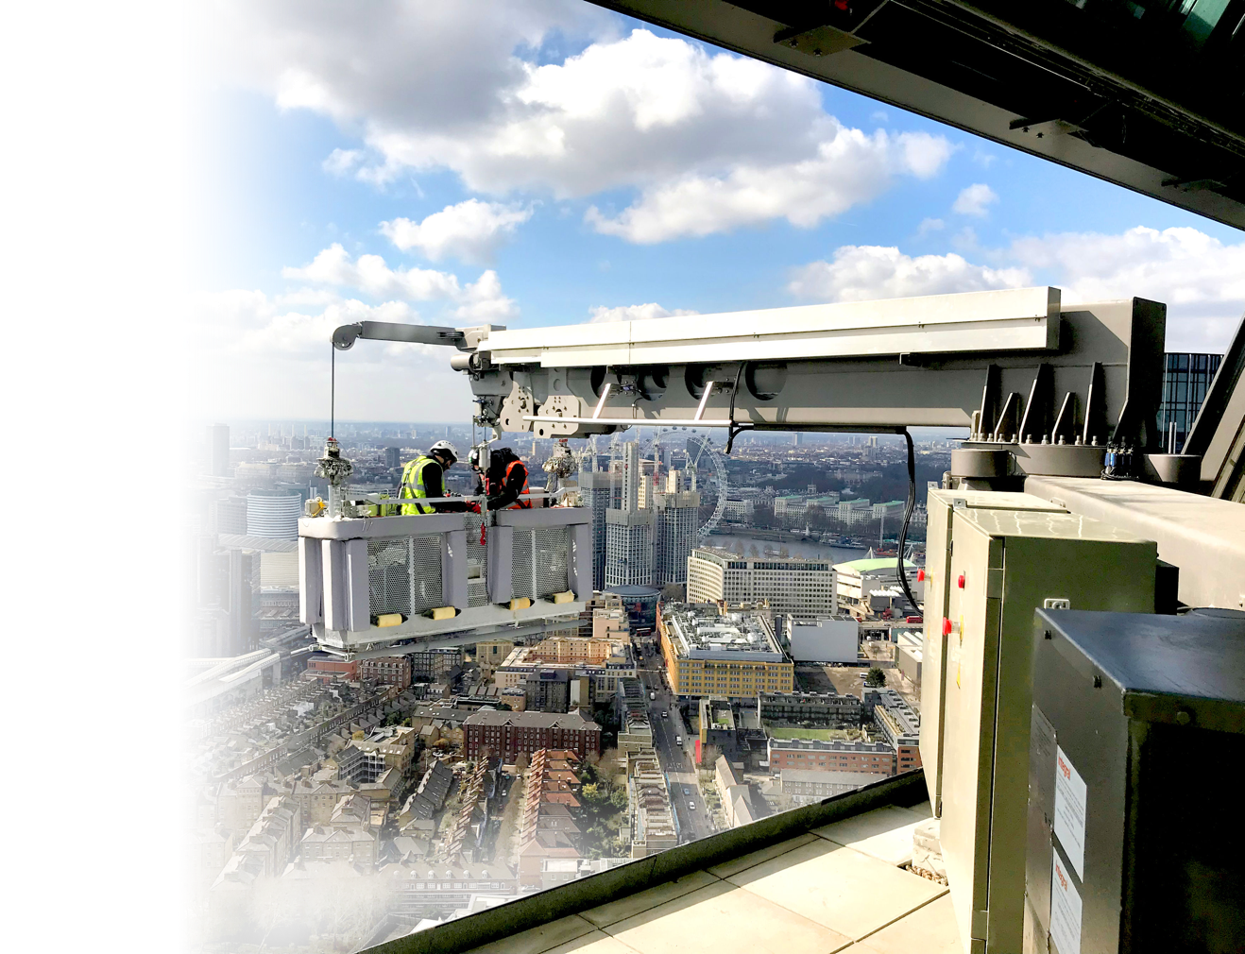
High-Level Cleaning
Cleaning building façades, cladding and windows – gaining access via a building maintenance unit (BMU).
Monthly schedules
Quarterly schedules
Yearly schedules
3

Slide 5
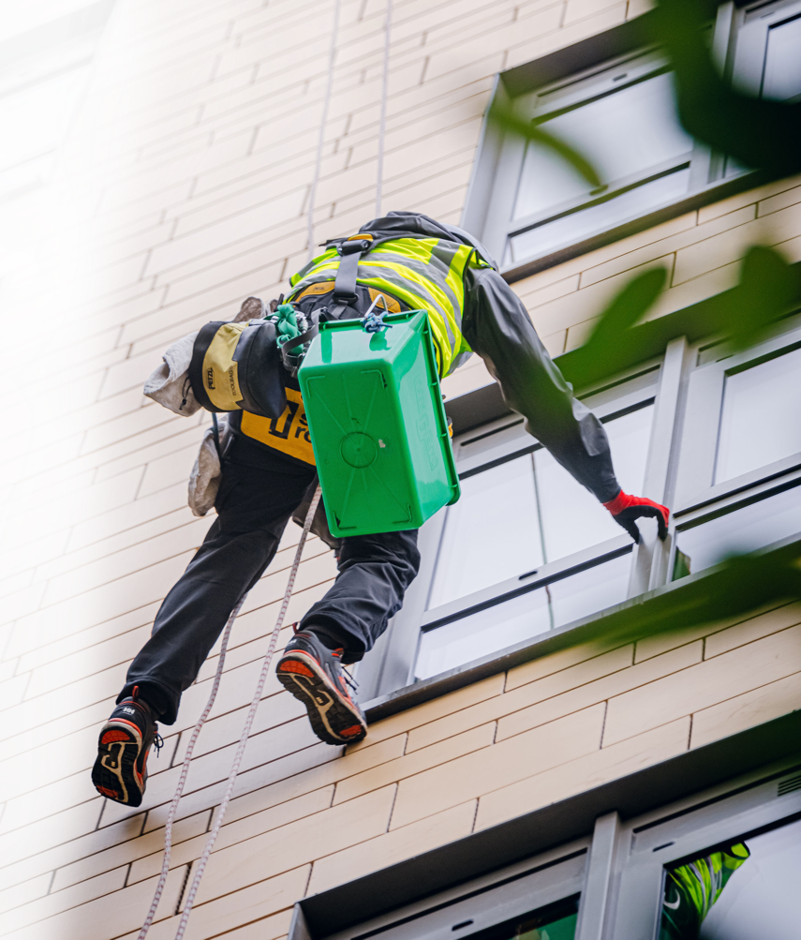
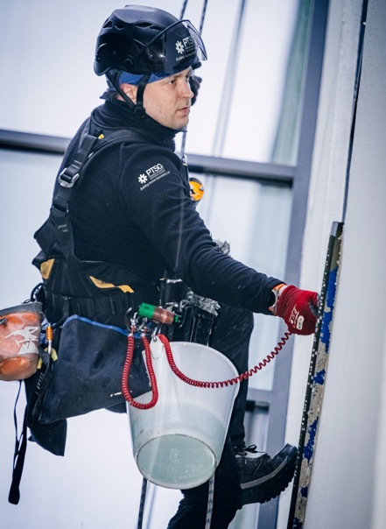
High-Level Window Cleaning
Window cleaning by Rope Access / Abseiling.
4

Slide 6
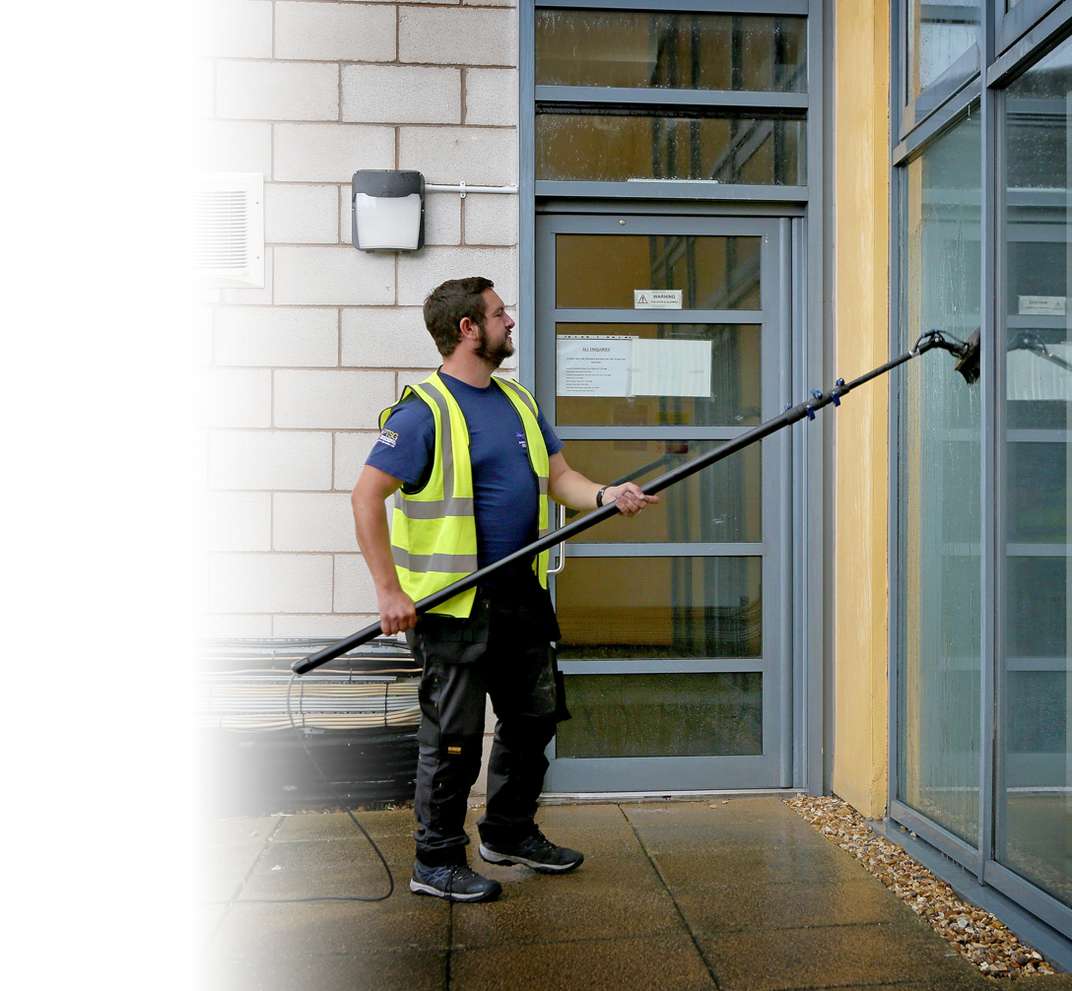
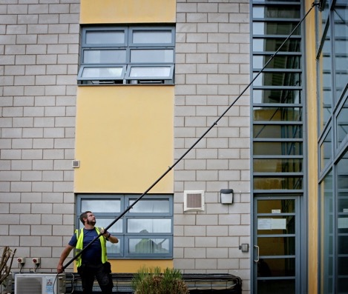
Reach and Wash
Window Cleaning
Reach and Wash delivered Nationwide for Residential / Retail and Commercial Property companies.
5

Slide 7
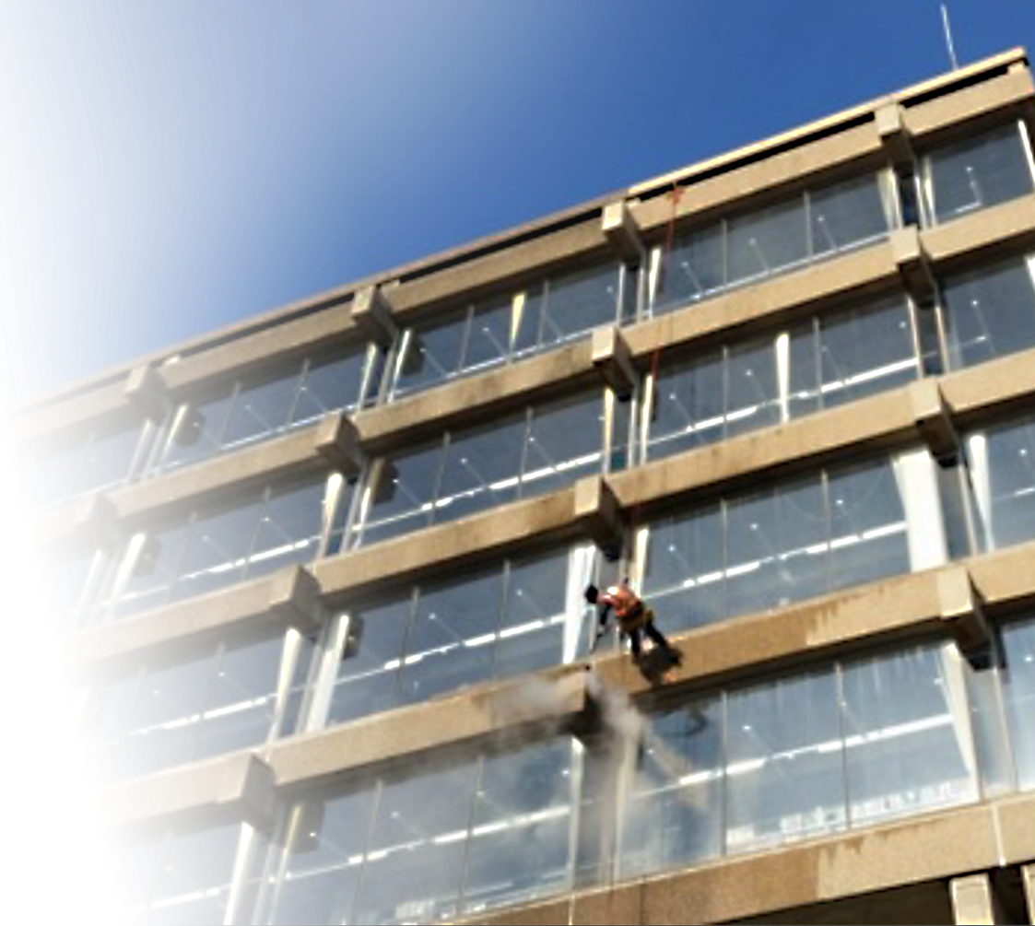
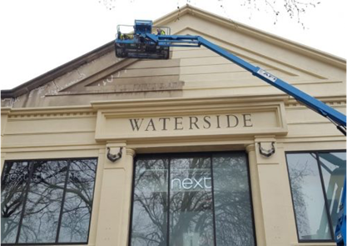
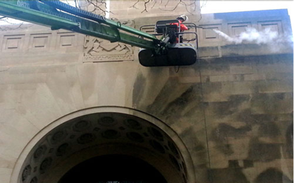
Stone and Brick Cleaning
Specialist Stone Cleaning
Variety of systems: traditional jet-wash or doff steam cleaning
(approved by English Heritage)
Access by MEWP/Rope Access/Scaffolding
6

Slide 8
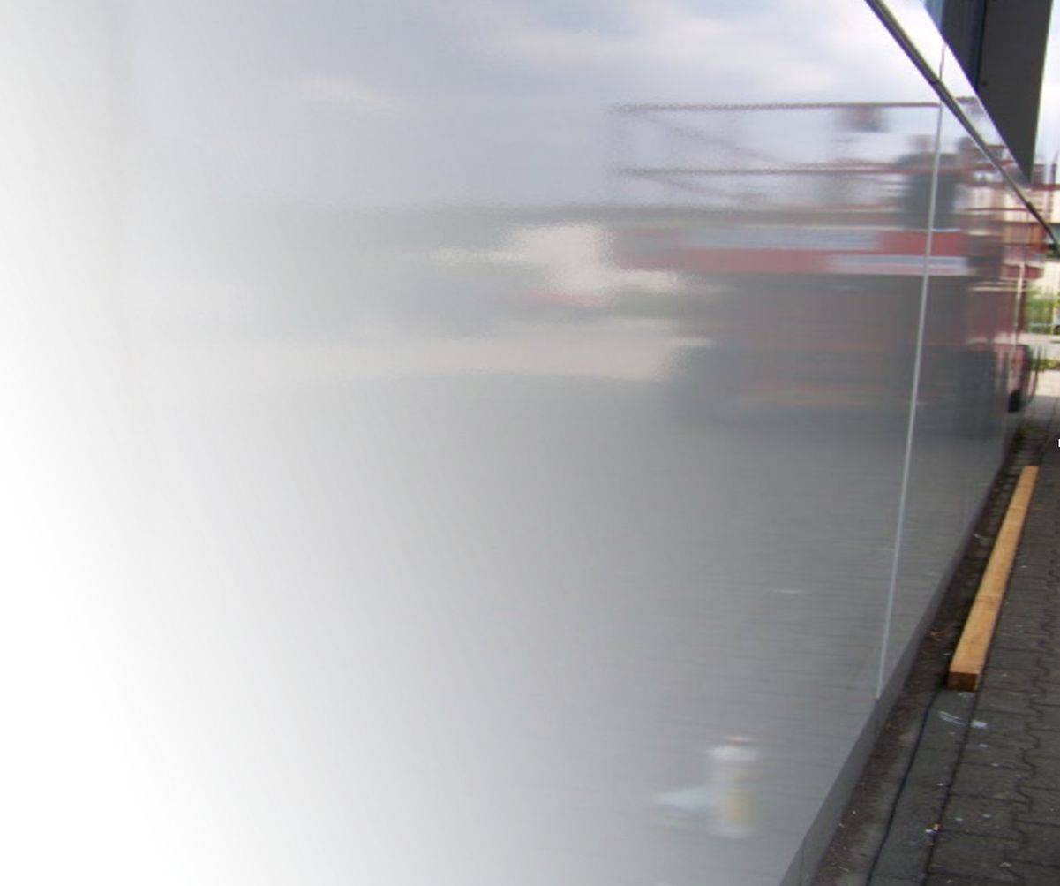
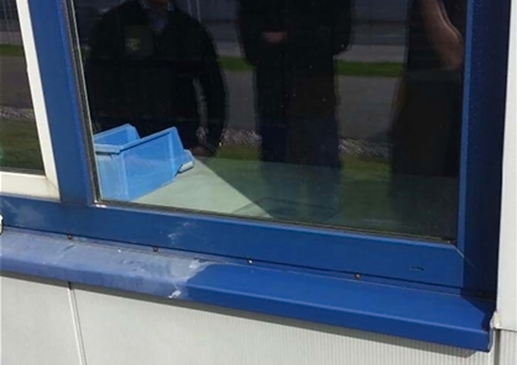
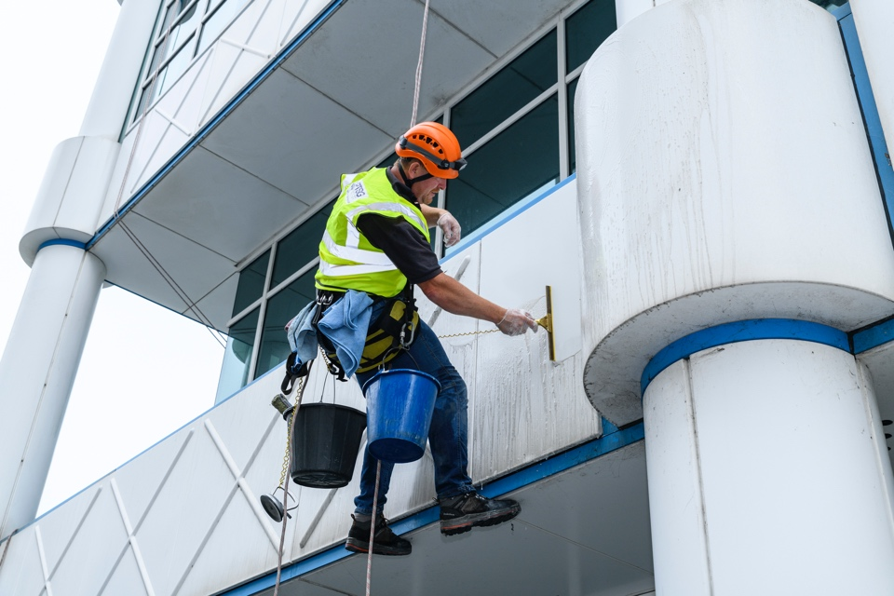
Specialist Cladding Cleaning
Restoring powder coated cladding and windows frames.
Bringing back the shine to cladding using proven methods.
7

Slide 9
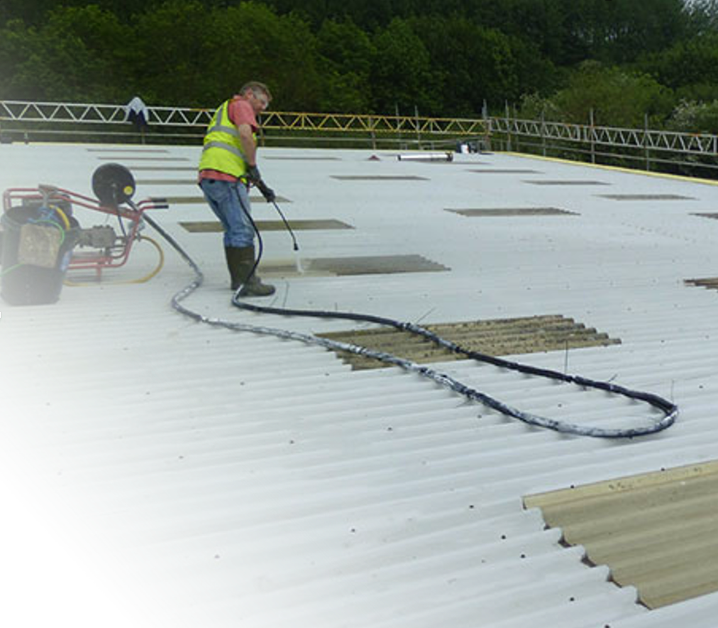
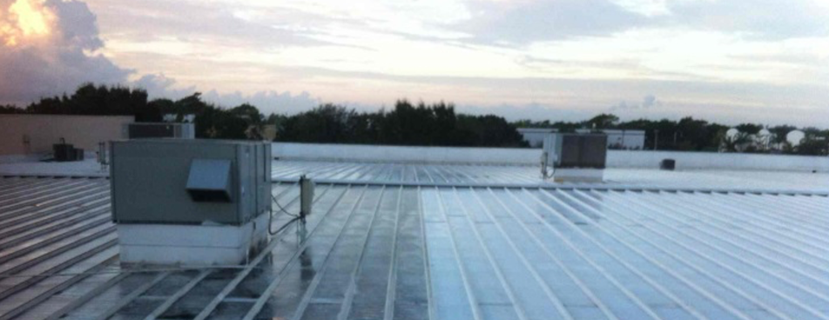
Roof Cleaning
Power washing roofs every few years can help reduce repairs costs in the long run.
8

Slide 10
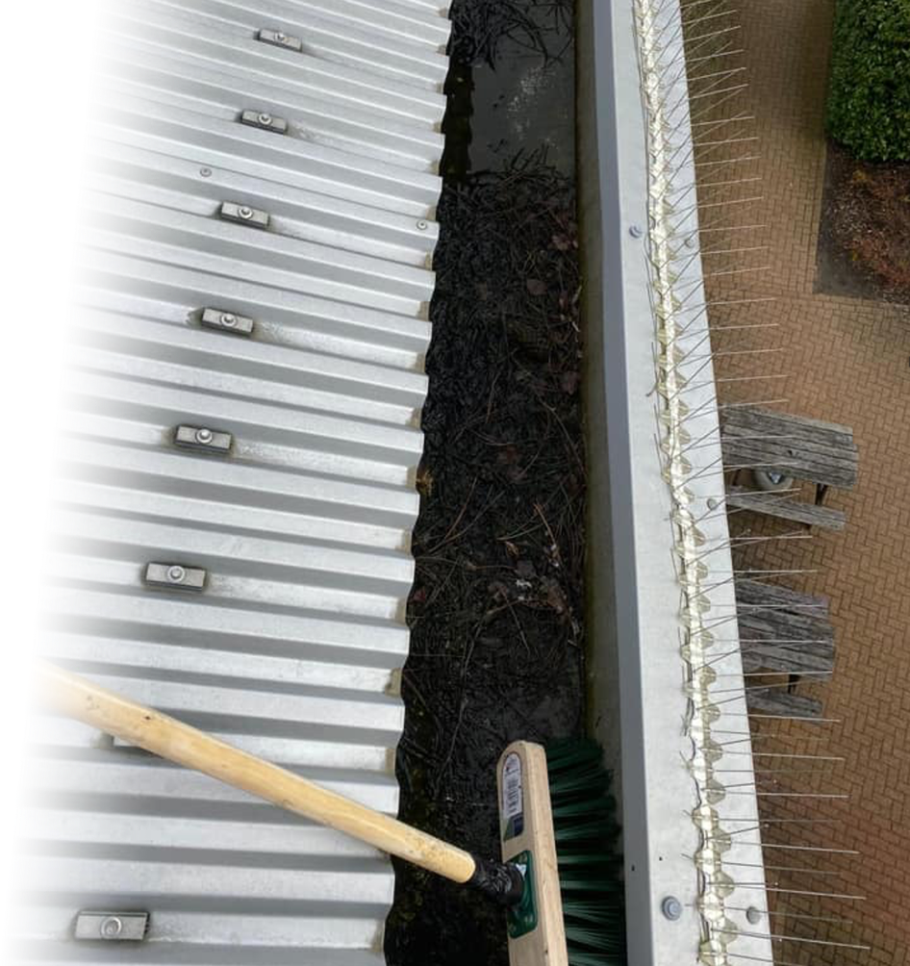
Gutter Cleaning
Gutter cleaning manually or using SkyVac systems.
Nationwide coverage
Six-monthly or Yearly service
9

Slide 11
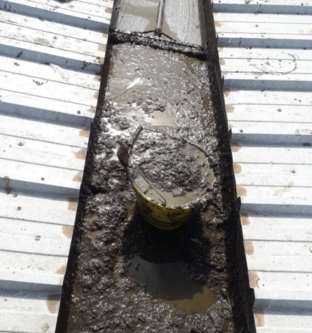
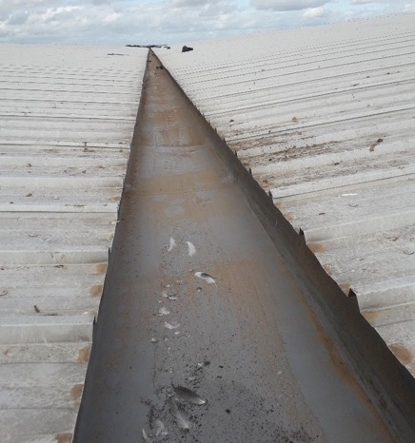
Gutter Cleaning
Before
After
10

Slide 12
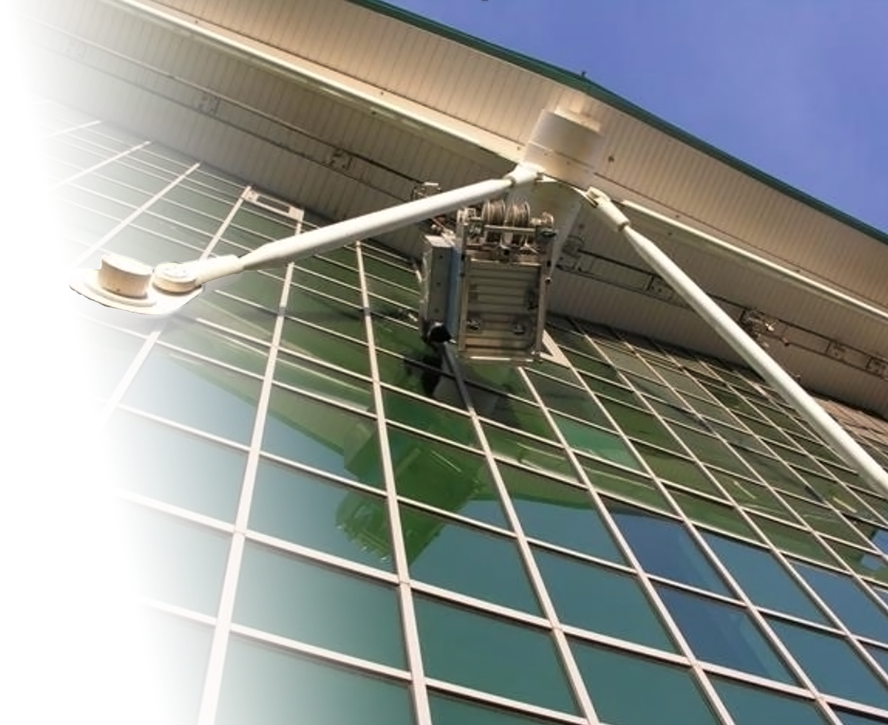
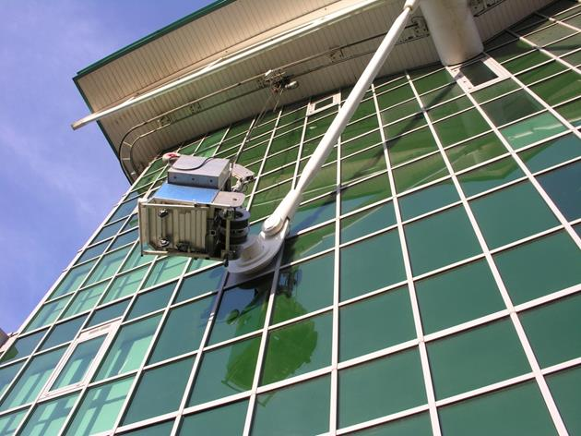
Inspections
Cladding inspections
External elements inspections
Removal and replacements if deemed unsuitable or damaged
11

Slide 13
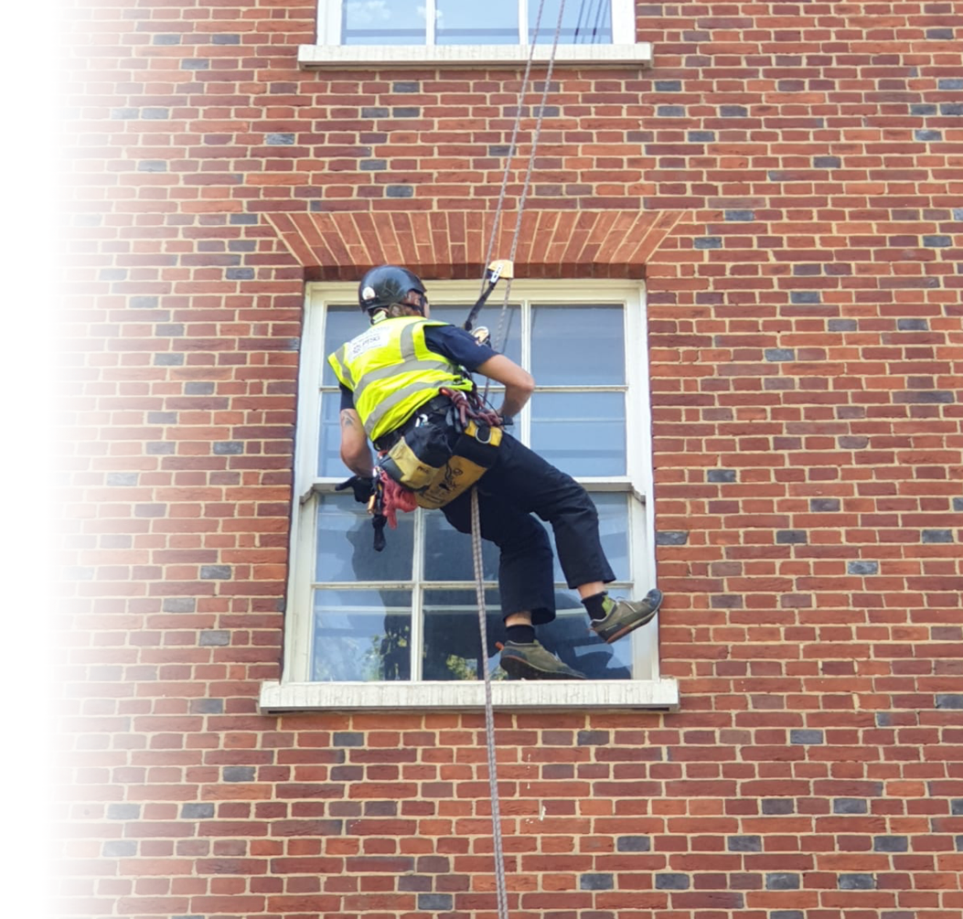
Window Surveys
Surveys completed by Rope Access or MEWP.
Photographic Evidence reports on completion including defect information.
12

Slide 14
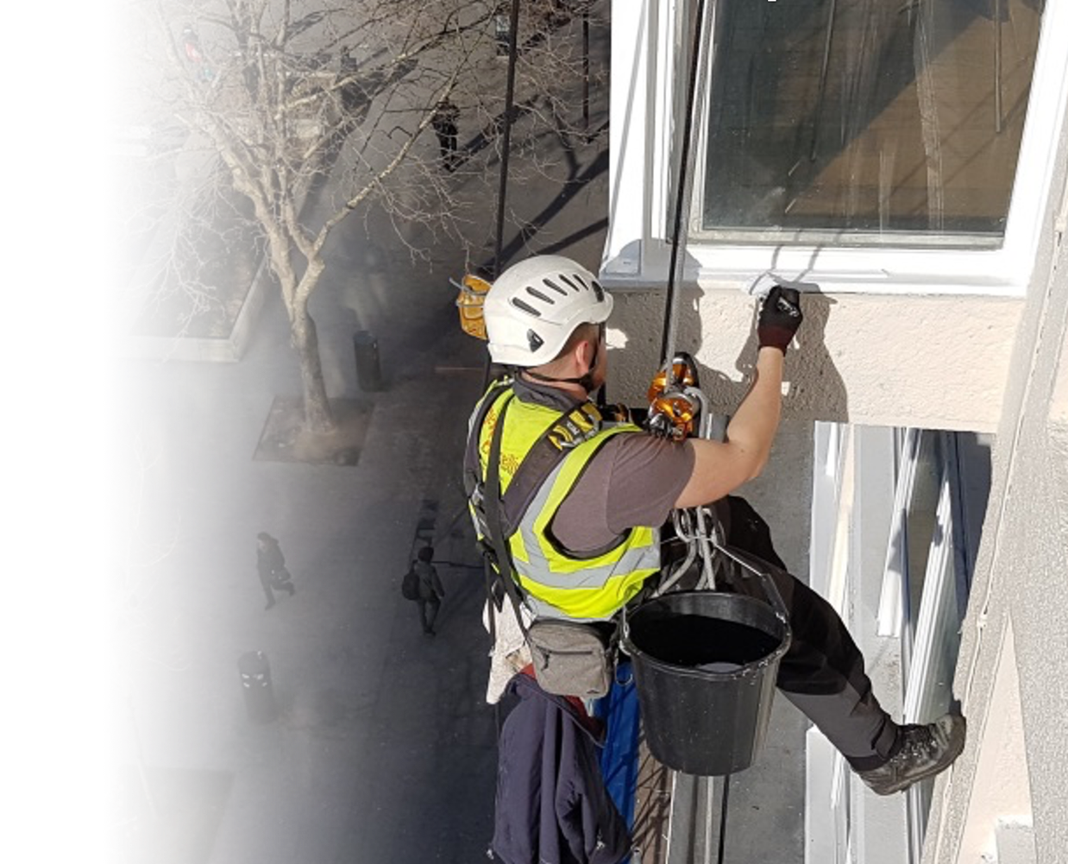
Redecoration
Window Repainting
Façade
Brick Tinting
Railing decoration
13

Slide 15
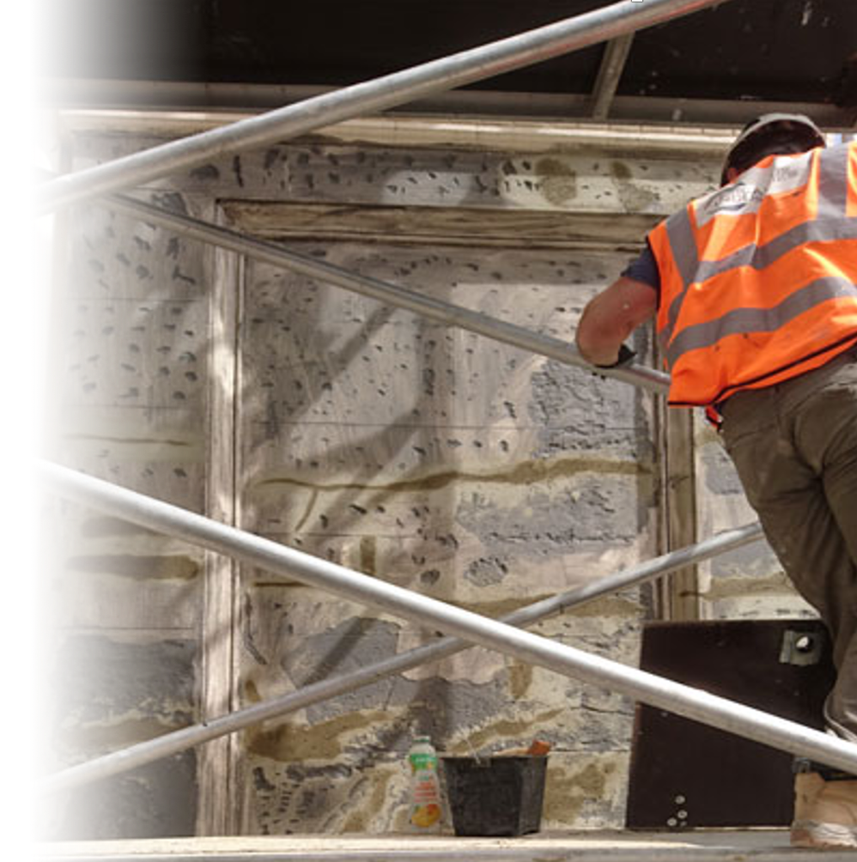
Stone Restoration
Brick and stone repairs and restoration
(Brick, Limestone & Portland Stone)
In house experiences Stone Masons
Mortar replacements
Stone protection to reduce cleaning costs
14

Slide 16
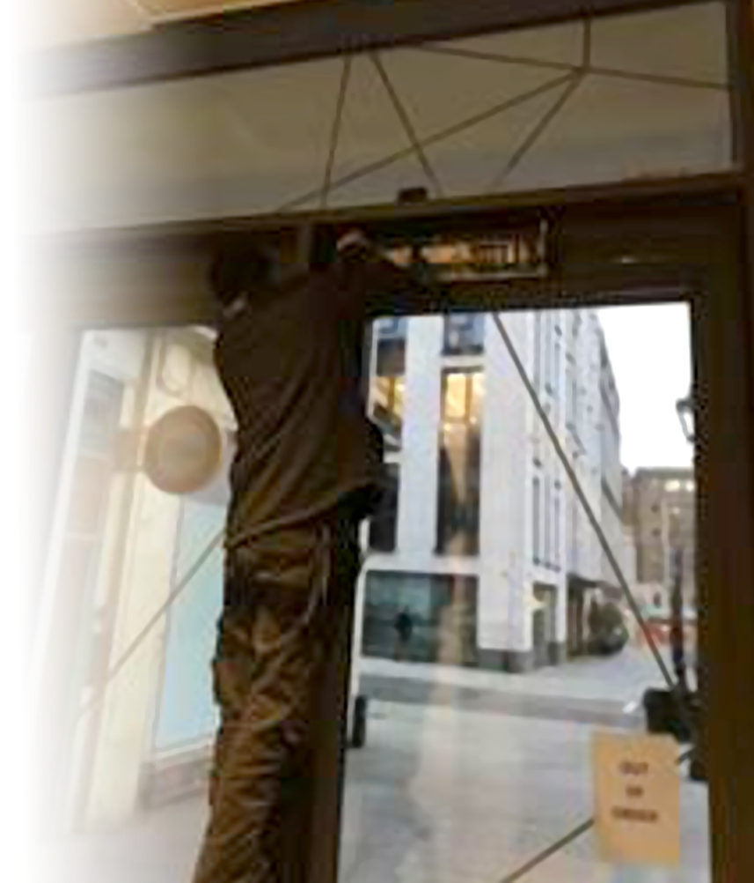
Reactive Automatic Door
& Window Maintenance
Low reactive rates
Thriving on very high first time repair and fast responses
Low works spend limit
Travelling time two hours from London
Nationwide coverage
15

Slide 17
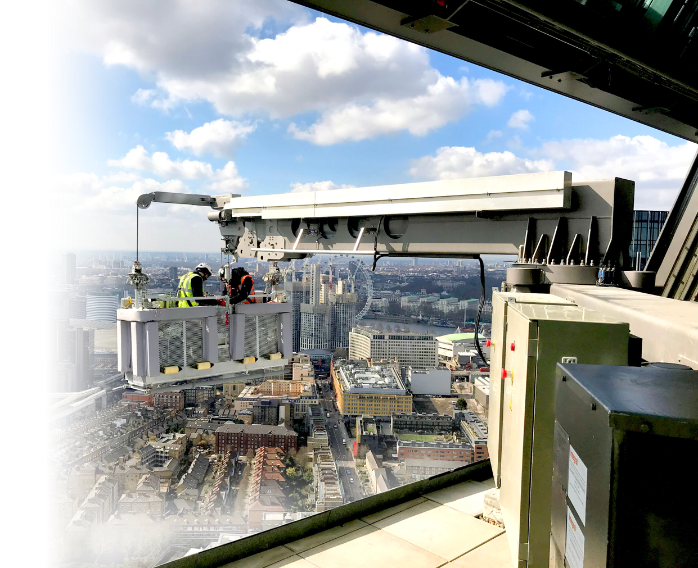
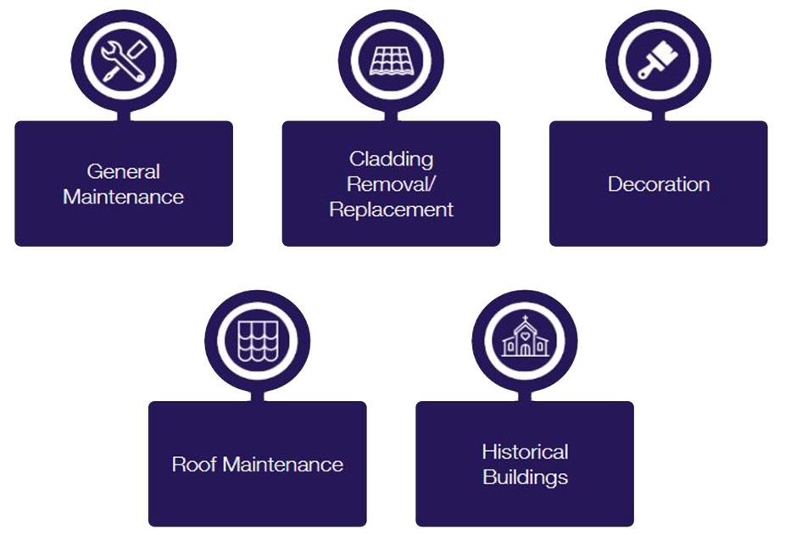
Types of Building Services
16

Slide 18

Areas of Specialism
Steeplejack Services
High-Level Installations
High-Level Reparation
High-Level Cleaning
Internal Cleaning
Contact Us
17

Slide 19
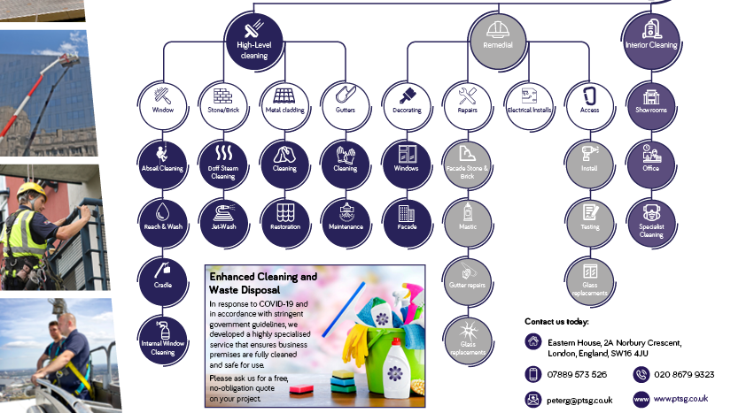
PTGS BAS Ltd on a Page
Welcome to PTSG Building Access Specialists Ltd - the home of high-level building access solutions for commercial, residential, industrial and public buildings.
Our team has many years’ experience in delivering a wide range of specialist services at height. Our unique extensive knowledge of working at height means that we can access virtually any part of any building – either internally or externally for cleaning and refurbishment purposes. The home of high-level building access solutions for commercial, industrial, public buildings and residential properties.
18

Slide 20
Need a quotation please contact us.
Thank you.
18

